Slide 1

Why pecs?
PICTURE EXCHANGE COMMUNICATION SYSTEM (PECS)
Anne Eichberger, M.A., CCC-SLP
Child Learning & Enrichment Medical Center
Autism Around the World Conference
Zayed University, DUBAI, U.A.E.

Slide 2
Objectives
To summarize the basic theory of Picture Exchange Communication System (PECS)
To determine the efficacy of the intervention by literature review in narrative form
To address the myths that surround PECS

Slide 3
Why do we communicate?
To express needs and wants
To develop social closeness
To exchange information
To fulfill social etiquette routines
Light 1988

Slide 4

Challenges
An estimated 1/3 to 1/2 of children and adults with autism do not use speech functionally.
(National Research Council, 2001)

Slide 5
Non-Functional Speech Difficulties
Frustration
Loss of independence reliance on others
Lack of control over decisions
Learned helplessness
Confrontation, Tantrums

Slide 6
Communication Bill of Rights
“All persons, regardless of the extent of their disability, have a basic right to affect, through communication, the conditions of their own existence.” (National Joint Committee for the Communicative Needs of Persons with Severe Disabilities, 1992)
#1 Right…
The right to request desired objects, actions, events, persons and to express personal preferences or feelings.

Slide 7
Augmentative and Alternative Communication (“AAC”)
AAC
Symbols/Aids
Techniques
Strategies
ASHA 1991

Slide 8
What is PECS?
Developed by Andy Bondy, Ph.D. & Lori Frost, M.S., CCC-SLP in 1985
Teaches functional communication that is immediately useful by exchanging visual symbols for communication purposes
Based on principles of Applied Behavior Analysis and on B.F. Skinner’s 1957 book, “Verbal Behavior”
Fields of applied behavioral analysis + speech-language pathology = effective method of teaching functional communication
Bondy & Sulzer-Azaroff 2002

Slide 9
What does the child learn?

Slide 10
What does the Child Learn?
Initiation: child learns to be spontaneous and act without prompting, more control over self-expressions
Concrete Outcomes: receiving a tangible, desired item teaches the child to value the act of communicating with others and is a powerful motivator to drive learning
Social Context: skills generalized in order to be used in a variety of environments

Slide 11
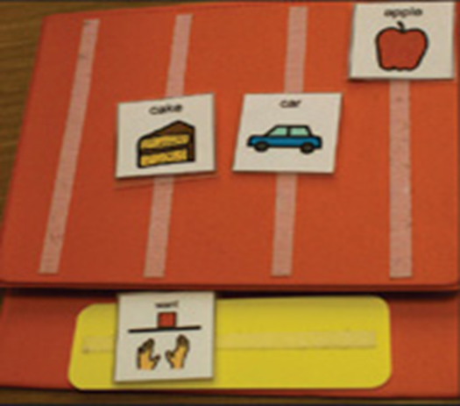
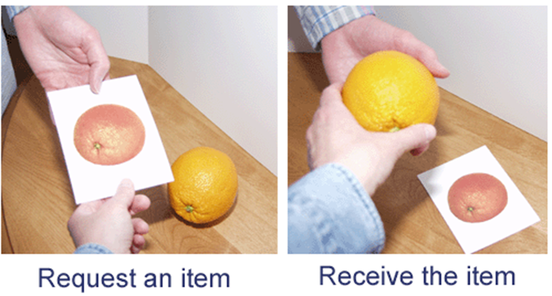
Components
Participants
Reinforcer
Velcro book

Slide 12
How does PECS Work?
phrases | Target Skill
Phase 1 | Physical exchange of picture
Phase 2 | Distance and persistence
Phase 3 | Picture discrimination
Phase 4 | Building Sentences and Attributes
Phase 5 | Answering “What do you want?”
Phase 6 | Responsive and spontaneous commenting

Slide 13
Possible PECS Candidate?
Is the student using functional communication?
NO
YES
PECS may be appropriate
Is the student’s communication understandable to unfamiliar listeners?

Slide 14
NO
YES
PECS may be appropriate
Is the student initiating communication?
NO
YES
PECS may be appropriate

Slide 15
Are the student’s mean length of utterance and vocabulary size adequate?
NO
YES
PECS may be appropriate
PECS is NOT appropriate

Slide 16
PECS Popularity
Clear and intentional
Requires few motor movements
Meaningful and motivating
Inexpensive and portable
Large number of communicative partners

Slide 17
Myths
PECS is only used for people who don’t speak at all
System targets initiation and purpose
PECS only teaches the child to learn to request using single words
Requesting is the first skill taught
Progresses to using sentence structure, answering questions, and finally expands to commenting.

Slide 18
Myths
If PECS is used, the learner won’t learn how to speak.
Research conducted over the past 30 years has demonstrated that augmentative and alternative communication strategies do not inhibit the development of speech. Many researchers have reported a facilitation of speech when AAC strategies are used.
Schwartz, Garfinkle, and Bauer (1998) children who initially had a limited spontaneous vocal repertoire continued to have increases in spontaneous language following PECS training.

Slide 19
Myths
If the child is starting to speak, stop PECS immediately
  No evidence to support that taking away pictures will promote more speech
  Anecdotal information shows the opposite effect
  If you take away skills (by taking away pictures) that is unethical

Slide 20
Cognitive Basis of Autism: Profile of Cognitive Strengths/Weaknesses
(Minshew, Goldstein & Siegel, 1997; Williams, Goldstein & Minshew, 2006)
Intact abilities
Attention
Sensory perception
Elementary motor
Simple memory
Rule-learning
Visiospatial processing
Cognitive weakness
Complex sensory
Complex motor
Complex memory
Complex language
Complex formation

Slide 21

Why is Language Processing Difficult?
Functional Magnetic Resonance Imaging (fMRI) study
Kana 2006; adults with autism used brain areas typically associated with visual imagery even if these areas were not needed for the language processing task
Koshino et al., 2005; individuals with autism did not automatically recode visual information into language, potentially making it more difficult for them to use language to scaffold learning and memory processes

Slide 22
Implications for Language Intervention
Visually based supplementation increases understanding by:
Making concepts more understandable
Making material is stable over time
Creating an “eye-catcher” for capturing and maintaining attention
Prompting the student
Helping minimize anxiety
(Twachtman-Cullen 1998)

Slide 23
A Review of the Efficacy of PECS Intervention Deborah Preston & Mark Cater 2009
Search Strategy:
Journal articles 1992- 2007
Used PECS as whole or part of an intervention strategy
Results had to include data on results of intervention
Research Design:
456 participants in 27 studies 88% received PECS intervention, 14% non – or alternative intervention groups 377 (83%) were described as having ASD 43% males, 8% females, 48% gender unstated Settings: various | Ages: 20 months – 40 years Single-subject studies Randomized control trials Group Designs

Slide 24
Efficacy & Effectiveness
Total group of 394 individuals who received PECS intervention
A great majority successfully mastered at least some phases of PECS, however 3 individuals were unsuccessful
Liddle 2001; child reported as being unsuccessful at mastering phase 1
Soner et al 2006; 1 adult had difficulty with motor and cognitive demands of training
Ticani 2004; 1 adult was more successful with manual signs than PECS

Slide 25
Speech Development
Charlop-Christy et al. (2004);
  Increases in speech during PECS training
Tincani et al. (2006);
  Dramatic increase in Phase IV
Yokoyama et al. (2006);
  Increase in frequency and intelligibility of vocalizations during PECS training phases I- IV
Ganz & Simpson (2004);
  Increase in words per trial during phases III & IV
Howlin et al. (2007);
  Little to no effect on speech
Yoder & Stone (2006a);
  PECS groups showed significantly greater increase in frequency of speech and in number of different words used verses Responsive Prelinguistic Mileu Teaching intervention

Slide 26
Socio-Communication Functions
Charlop-Christy et al. (2002);
  Requesting and initiations were proven to increase the most, occurring on an average of 2.8 times per session at baseline to 27 times
  Joint attention and eye contact increased from 30% from baseline to 60% post treatment
Kravits and Colleagues (2002);
  Increase in duration of social interaction with peers
Ticani et al., (2006);
  Increases in manding (requesting) from 0% at baseline to approximately 55% post treatment
Yoder & Stone (2006b);
  Those higher in initiating joint attention before treatment showed greater increases in initiating joint attention and requesting following RPMT intervention, however those that were Initially lower in initiating joint attention showed greater increases following PECS intervention

Slide 27
Behaviors
Charlop-Christy, et al., (2002);
  70% reduction in 10 of the 12 behaviors after implementation of PECS, and four of the behaviors were completely eliminated from the child’s everyday actions
  Tantrums and getting out of their seat without permission during sessions decreased from about 20% to 7% after training
Granz & Simpson, (2004);
  In a 4 year old preschool classroom, PECS was used to decrease autistic children’s aggressive behavior and was successful

Slide 28
Maintenance Generalization
5 studies provided data maintenance
Results: inconclusive
15 studies included data on generalization
Results: majority were positive, skills generalized to different settings, people and stimuli

Slide 29
Efficacy Review- Discussion
Research has shown: Many benefits of PECS
Children able to develop PECS skills quickly
Increase in spontaneous communication
Increase in verbal communication
Increase in social interactions
Able to generalize skills
Figures support the preliminary conclusion PECS is an effective intervention

Slide 30
Conclusion
A functional communication system allows someone to express himself
PECS can be the first step in the path of social interaction
Using a low tech AAC system, such a PECS, to begin provides functional communication to teaching a person “how” to communicate
When mastered, consider other methods for developing communication

Slide 31
To Learn More…
Pyramid Educational Systems: www.pecs.com
ISAAC – the International Society for Augmentative and Alternative Communication: www.isaac-online.org/english/home

Slide 32
References
Bell, N Visualizing and Verbalizing for Language Comprehension and Thinking
Bondy, A., & Frost, L. (2002), A picture’s worth : PECS and other visual communication strategies in
autism. Bethesda, MD: Woodbine House
Bondy, A., & Frost, L. (1998). The picture exchange communication system. Seminars in Speech
and Language, 19, 373-389.
Bondy, A. & Frost, L. (2001). The Picture Exchange Communication System. Behavior Modification,
25, 725-744.
Charlop-Christy, M., & Jones, C. (2006). The picture exchange communication system. In R.
McCauley and M. Fey (Eds.), Treatment of language disorders in children (pp. 105-122).Baltimore,
MD: Paul H. Brookes.
Light, J., (1997) Reflections on the contexts of language learning for children who use aided AAC.
Alternative and Augmentative Communication, 13, 158-171.
Light, J.C., Roberts, B., Dimarco, R., & Greiner, N. (1998). Augmentative and alternative
communication to support receptive and expressive communication for people who have autism.
Journal of Communication Disorders, 31, 153-180.
National Research Council. (2001). Development of Communication. In National Research Council,
Educating children with autism (pp 47-65). Washington, DC: National Academy Press.
Preston D, Carter M, A review of the efficacy of the picture exchange communication system
intervention. Journal of Autism and Developmental Disorders (2009) Volume: 39, Issue: 10,
Pages: 1471-86

